Slide 1

Weekly Report 10/16/2018
Christina Chen

Slide 2

Tasks Last Week
Plotting ⁴⁶Ar proton events for DNP poster
Coding the Monte Carlo fitting for proton tracks - continued

Slide 3

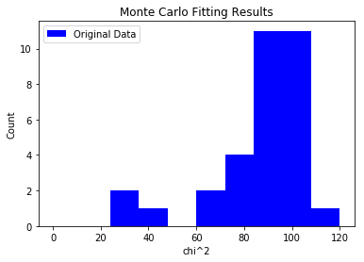
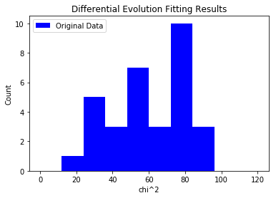
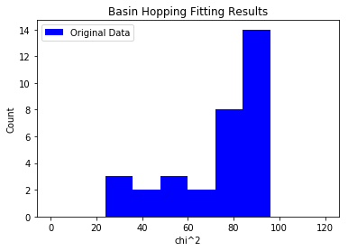
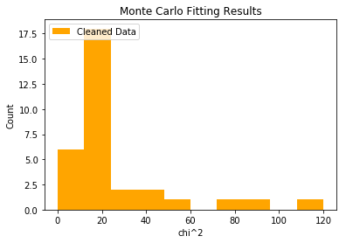
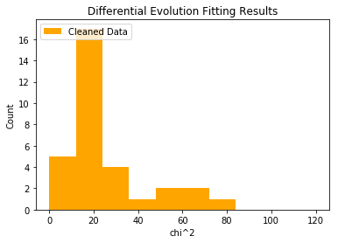
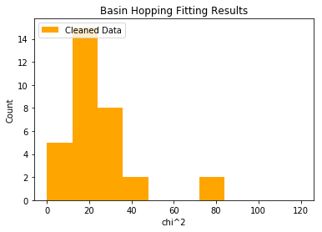
32 Nicer Tracks – original and cleaned
Chi^2 = 86.79
Time = 1.34s
Chi^2 = 61.24
Time = 43.61s
Chi^2 =73.07
Time = 17.70s
Chi^2 = 26.32
Time = 0.695s
Chi^2 = 25.05
Time = 59.68s
Chi^2 =24.53
Time = 9.42s

Slide 4
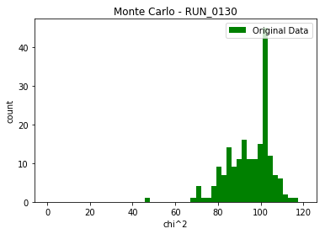
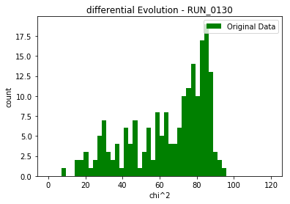
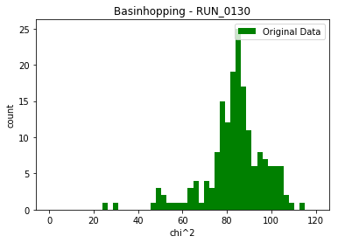
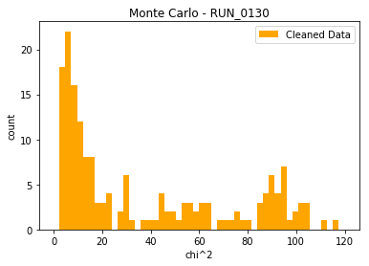
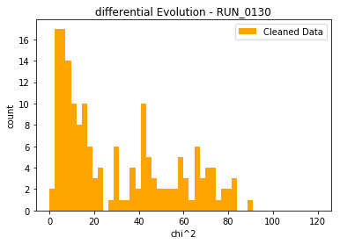
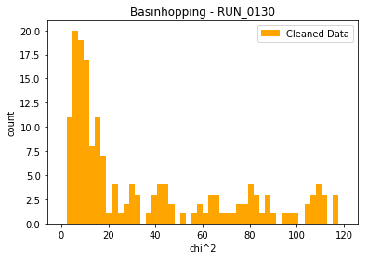
>170 hand-labeled proton events
Chi^2 = 94.46
Time = 2.15s
Chi^2 = 65.27
Time = 68.83s
Chi^2 = 83.16
Time = 38.43s
Chi^2 = 39.34
Time = 0.77s
Chi^2 = 27.29
Time = 58.39s
Chi^2 = 29.51
Time = 11.43s

Slide 5
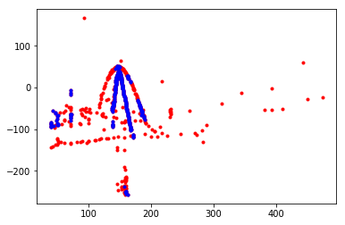
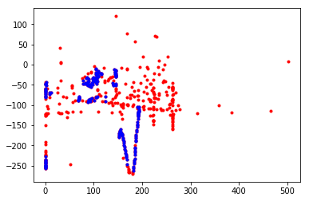
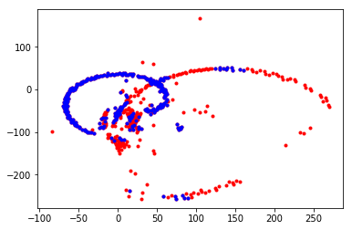
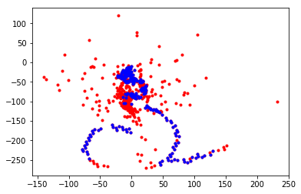
Question: Should events like this be included as a proton event for classification?

Slide 6
Monte Carlo

Slide 7
Step #1: random event generator
uniform_param_generator function: 500 6-D parameters
Only includes events whose value in each element is within +/- sigma
Distribution_param_generator?
4.1.1.2 https://www.dropbox.com/home/nuclear_resources_Chen?preview=bradt-thesis.pdf

Slide 8
Step #2: track generation for each simulated event
EventSimulator
Returns 2-D arrays with each data point’s x, y, z, a, pad

Slide 9
Step #3: linear interpolation
interpolate.interp1d(sim_xyzs[:,2],sim_xyzs[:,0],bounds_error=False, fill_value =“extrapolate”)
Simulated track’s x and y components are linearly interpolated as a function of z
For out of range values of x(z) and y(z), what fill_value should it be? (NaN, a number, etc)
Right now fill_value is 0.0

Slide 10
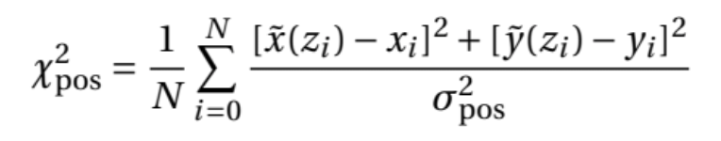
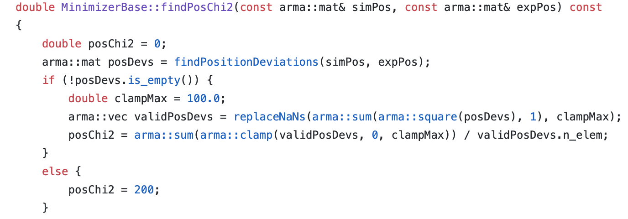
Step #4: replace NaN’s
Replace NaN’s in x(z) and y(z) with what value?
Right now it is replaced with 0.0

Slide 11

Step #5: calculating position chi^2
$χ_{pos}^{2}=\frac{1}{N_{hit}}Σ{(1−\frac{x(z_{i})}{x_{i}})}^{2}$+ ${(1−\frac{y(z_{i})}{y_{i}})}^{2}$
$=\frac{1}{N_{hit}}Σ{(\frac{x_{i}−x(z_{i})}{x_{i}})}^{2}$+ ${(\frac{y−y(z_{i})}{y_{i}})}^{2}$

